Slide 1

ML-Based Fetal Health Monitoring and Prediction
Team members
P Sujith
A Pavani Anvitha
P Samapath
C Kishan Reddy

Slide 2

Introduction
"Fetus Monitoring System is an advanced healthcare solution that leverages machine learning algorithms, to analyze vital physiological parameters for accurate classification of fetal health, enabling early risk detection and informed prenatal care."

Slide 3

Motivation:
Early detection of fetal health issues can significantly reduce complications during pregnancy. The project aims to develop an accurate prediction system to classify whether the fetus is healthy or unhealthy.

Slide 4

Objective
The goal is to analyze data like heart rate, temperature, and movements of the fetus.
The system will predict if the baby is healthy or unhealthy using machine learning.
We will test different models like Gradient Boosting, Logistic Regression, SVM, and Random Forest.
The aim is to create a tool that helps Pregnant ladies to detect risks early and provide better care.

Slide 5

Problem Survey
•In emergencies or when doctors are unavailable, it becomes challenging to monitor the health of a baby during pregnancy.
•Traditional methods may not provide quick or complete information about the baby's condition.
•This creates a need for a system that can measure key health indicators and predict the baby's well-being accurately, helping to detect problems early and provide timely care.

Slide 6

Methodology
Data Collection
Data Preprocessing
Model Selection
Model Training
Model Evaluation
Prediction
Deployment

Slide 7
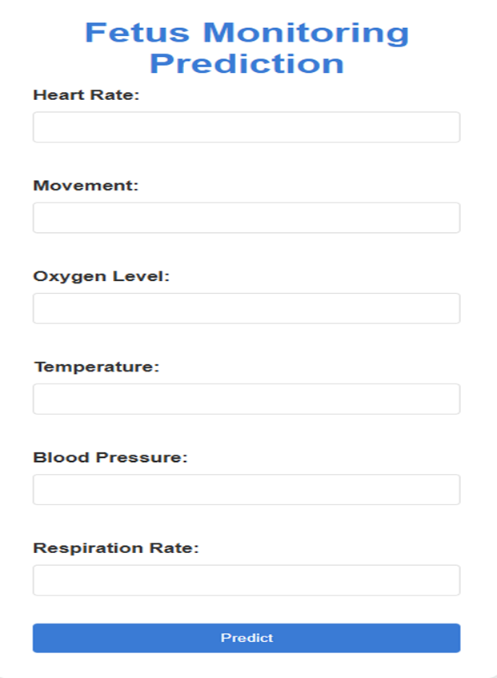
Interface
It’s user-friendly and straightforward, with fields for entering essential fetal health parameters like Heart Rate, Movement, Oxygen Level, Temperature, Blood Pressure, and Respiration Rate. After entering these values, the system uses the trained machine learning model to predict whether the baby is healthy or unhealthy, providing quick and reliable feedback.

Slide 8
Models Used
•Gradient Boosting
•A powerful ensemble method that builds models sequentially, improving accuracy by correcting errors made by previous models.
•Random Forest
•An ensemble algorithm that combines multiple decision trees to improve prediction accuracy and reduce overfitting.
•Support Vector Machines (SVM)
•A model that finds the optimal boundary (hyperplane) to classify data by maximizing the margin between classes.
•Logistic Regression
•A simple statistical model used to predict binary outcomes (e.g., healthy or unhealthy) based on input features.

Slide 9
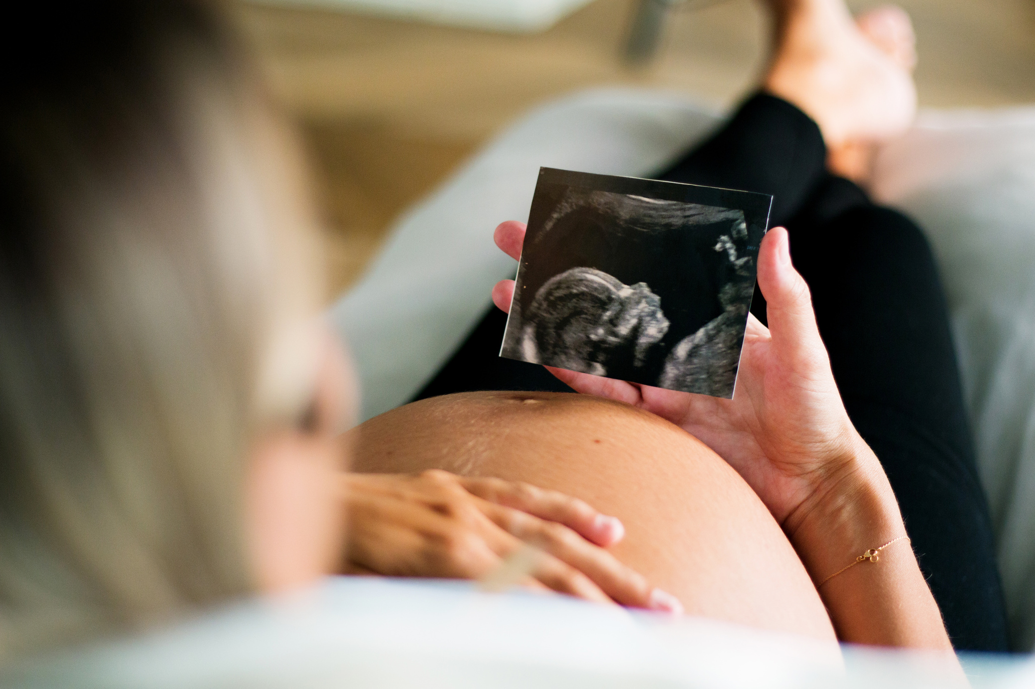
Objectives Achieved
Data Collection and Analysis:
We successfully collected and analyzed predefined fetal health data, including heart rate, movement, oxygen levels, temperature, blood pressure, and respiration rate.
Model Implementation:
We implemented and trained multiple machine learning models, including Gradient Boosting, Random Forest, Support Vector Machines (SVM), and Logistic Regression, to predict fetal health.
Model Evaluation:
The models were evaluated using accuracy, precision, recall, and F1 score to determine the best-performing algorithm for predicting whether the baby is healthy or unhealthy.

Slide 10

Prediction System:
A functional prediction system was developed, allowing users to input fetal health data and receive real-time predictions on whether the fetus is healthy or unhealthy.
Real-Time Application:
The system provides a simple, user-friendly interface that can be used in emergency situations or when doctors are unavailable, ensuring quick and reliable fetal health assessments.
Early Detection of Risks:
By using machine learning models, the system helps detect potential fetal health risks early, providing timely insights for healthcare professionals.

